Slide 1

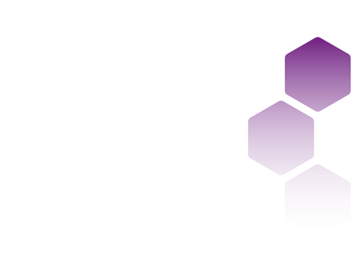
Machine Learning Part 2: Clustering
Louise Capener, Research Associate at the UK Data Service (Cathie Marsh Institute, UoM)
Copyright © year Institution. Created by Organisation, UK Data Service.
Notes:
Hi everyone, I’d just like to start by saying thanks for attending this webinar which is part 2 in our Machine Learning series. My name is Louise Capener and I’m a research associate, working as part of the CSS team (computational social science team) within the UKDS. Those of you who attended Monday’s webinar will have met my colleague Nadia Kennar who will be helping facilitate in the background today, so any queries or questions, she’s got you covered.

Slide 2
Interaction
During this workshop you can use the Zoom chat for technical questions or comments (to chat with the facilitator – Nadia Kennar).
If you want to ask questions in relation to the content of this talk, then you can use the Zoom Q+A function.
Notes:
Just a few preliminary things before we get started. So, during the workshop if you have any technical questions or comments you can pop them in the Zoom chat which my colleague Nadia will be overseeing.
And if you have any questions related to the content, you can use the Zoom Q and A function, and at the end of the workshop I’ll answer them.

Slide 3
Can you hear us?
?
Notes:
And another important thing to cover is: can you hear me? You should see a zoom poll, where you can put yes or no.
Okay, great.

Slide 4
Troubleshooting audio problems
Check your speaker/headset is plugged in / volume is on.
Click on audio to change to listening via phone
We are recording this webinar and will post it on YouTube (https://www.youtube.com/user/UKDATASERVICE)
This workshop is being run live on Youtube
Notes:
If you are having issues though, here’s some things I recommend trying.
You know, check that your headphones are actually plugged in, classic mistake.
This webinar is being recorded and it’ll be posted on our YouTube at some point, and it’s also being run live on YouTube so hello to anyone watching from there.
Okay, let’s get started.

Slide 5
Outline
Recap
What is clustering?
Why bother with it?
Types of clustering algorithms
K-Means
Hierarchical clustering
Notes:
So, first we’re going to start with a small recap of last weeks session, talking about the differences between supervised and unsupervised learning.
Then, I’ll introduce clustering and what it is.
I’ll also cover why it’s useful, and why you should care about it.
Then, we’ll discuss some different types of clustering algorithms.
Finally, we’ll cover the K-Means algorithm and hierarchical clustering.

Slide 6
Recap
Supervised learning | Unsupervised learning
Input data is labelled | Input data is unlabelled
Data is classified based on the training dataset | Assigns properties of given data to classify it
Divided into Regression and Classification | Divided into Clustering and Association
Used for prediction | Used for analysis
Algorithms include: decision trees, logistic regressions, support vector machine | Algorithms include: k-means clustering, hierarchical clustering, apriori algorithm
A known number of classes | An unknown number of classes
Notes:
So, for those of you that attended our first Machine Learning talk, you might remember that we spoke about the different types of machine learning models. Machine learning algorithms generally fall into two main categories: supervised learning and unsupervised learning. (It should be said that there’s also semi-supervised learning – combines a small amount of labelled data with large amount of unlabelled data - and reinforcement learning, but we’re not going to cover/worry about those today).
In terms of supervised learning, last session, we covered some really simple examples including logistic regression, which leverges the power of machine learning to predict a binary outcome e.g., yes/no, cat/dog.

Slide 7
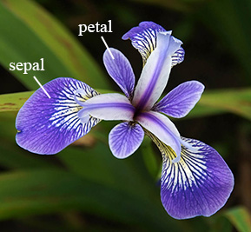
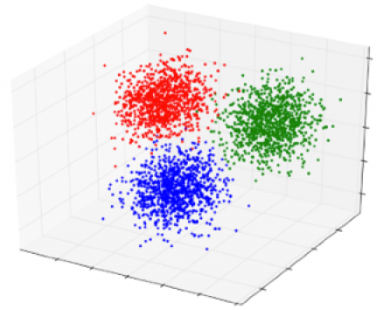
Recap (contd.)
Supervised learning: used for prediction
Dps | Sepal length (cm) | Petal length (cm) | Petal width (cm) | Species
A | 3.5 | 1.4 | 0.2 | Iris-Versicolour
B | 3.2 | 5.7 | 2.3 | Iris-Setosa
C | 3.2 | 5.9 | 2.3 | Iris-Setosa
D | 2.9 | 4.7 | 1.4 | Iris-Virginica
E | 3.7 | 1.5 | 0.4 | Iris-Versicolour
F | 3.1 | 5.5 | 2.2 | ?
Unsupervised learning: used for analysis
Dps | Sepal length (cm) | Petal length (cm) | Petal width (cm)
A | 3.5 | 1.4 | 0.2
B | 3.2 | 5.7 | 2.3
C | 3.2 | 5.9 | 2.3
D | 2.9 | 4.7 | 1.4
E | 3.7 | 1.5 | 0.4
Notes:
To illustrate the differences between supervised and unsupervised learning, I’m going to draw on the infamous Iris flower dataset (which is widely used as a beginner dataset for machine learning, and it’s also freely available online and with the Python ML package Scikit-learn). So, we have a collection of Iris flowers and we want to predict each flowers species based on attributes such as sepal length, petal length, and petal width.
To do this, I could create a supervised learning model which uses a training dataset that includes my independent variables (so that’s, sepal length, petal length ect.), and my outcome variable (the species/class I wish to predict). Once I have trained my model with this data, I would then be able to make predictions about the species of iris flower with unseen data points. You can see with the first dataset I have a new datapoint F on the green row. I can use the information supplied about the independent variables to assign this data point to a class.
Whereas, clustering algorithms are unsupervised, which means I only have input variables (so you can see I have x1 sepal length, x2 petal length etc), but no corresponding output variable. This contrasts with the previous example where we are trying to map an input (sepal length, petal length etc) to an output (which is our iris species). The clustering dataset contains datapoints that are unlabelled – you can see that we don’t know which species our data points A-E are.
So, our purpose in implementing a clustering algorithm will be different. Instead of using it to predict specific species, we can use it to model the underlying patterns and distribution of the data – which can still tell us a lot/implies a lot about iris species. Using clustering you might end up with a result like the 3d graph on the right, which groups the datapoints into 3 distinct clusters. However, in truth the Iris dataset only contains 2 clusters with rather obvious separation, so your results won’t always look as perfect as this graph!

Slide 8
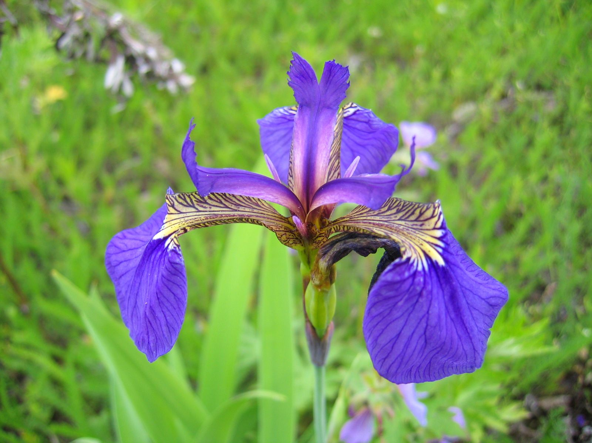

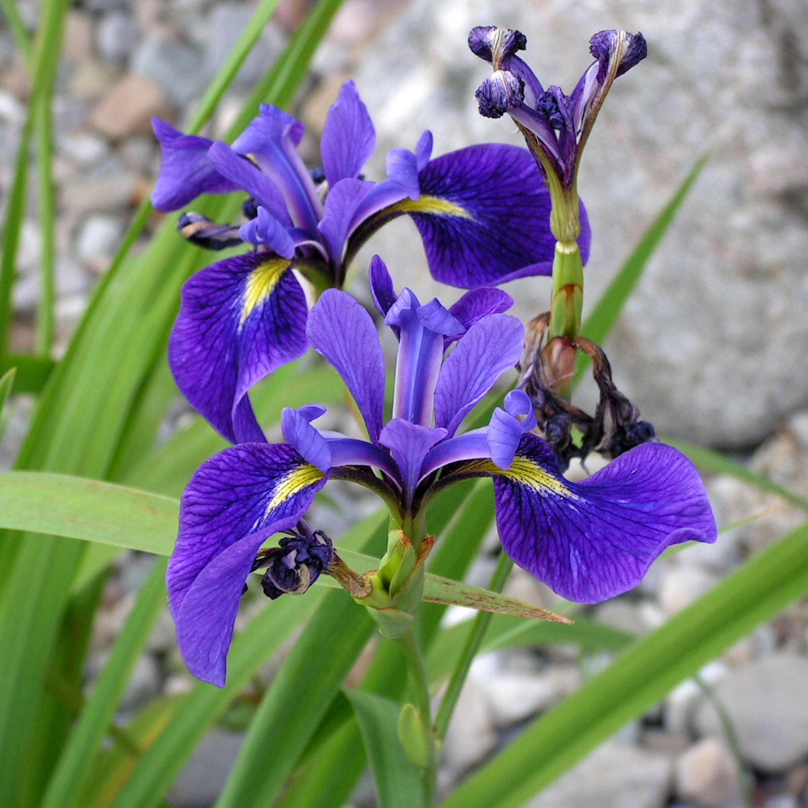
What is clustering?
cluster 1
“Clustering is the task of partitioning the dataset into groups, called clusters. The goal is to split up the data in such a way that points within a single cluster are very similar and points in different clusters are different.”
(Müller and Guido 2017)
cluster 2
cluster 3
Dps | Sepal length (cm) | Petal length (cm) | Petal width (cm) | cluster
A | 3.5 | 1.4 | 0.2 | 1
B | 3.2 | 5.7 | 2.3 | 2
C | 3.2 | 5.9 | 2.3 | 2
Notes:
So, what is clustering then? Clustering is the task of partitioning a dataset into groups, called clusters. The goal is to split up the data in such a way that points within a single cluster are very similar and points in different clusters are different. So, this is going to be different to supervised learning methods such as classification, which aim to assign our data to predefined classes (such as the different Iris species - Iris setosa, Iris virginica and Iris versicolor).
But, clustering works with datasets that are unlabeled, and we don’t have a known number of classes. So, the output of clustering algorithms will be this extra column here (which we have labelled cluster), where you can see that each data point has been assigned to a cluster.

Slide 9
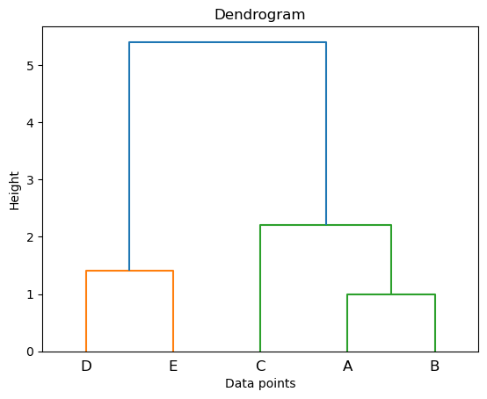
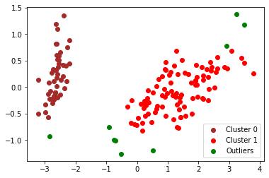
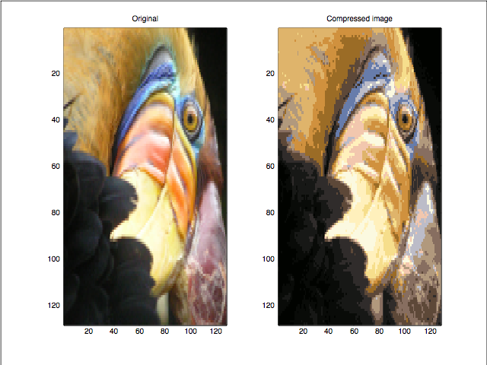
Why bother with it?
It provides more information on the structure of the data → patterns
It can help identify problems in the data, such as outliers
It can be used to compress data
Notes:
Clustering has many use cases which we’ll cover in just a second. But, I’ll just talk briefly about what makes clustering algorithms appeal to data scientists.
Firstly, and most importantly, as we have said, clustering can tell us about the underlying structure of the data. This can be extremely useful in highlighting patterns and identifying groups of similar objects/data points.
And by revealing the underlying structure of the data, this also allows us to identify possible outliers in our clusters. This can be done by calculating the distance of each data point from its center then defining our most distant points as outliers. This is shown on the image to the right, where the green points have been identified as outliers. We can then get rid of these data points so that they don’t distort our results or impede our statistical analyses.
Finally, clustering is also useful for image compression, which is a type of data compression applied to digital images – by compressing images this takes up less storage space on a device. It works by clustering similar colours together to reduce the number of colors on the image. Lossless compression is a method used to reduce the size of a file whilst maintaining the same quality as before it was compressed. Whereas, lossy compression is a method that compresses a photo to an even smaller size, by discarding some parts of the photo. On the right we have an image which shows the result of lossy image compression on a picture of a parrot (I think). As you can see we haven’t lost a great amount of detail – which is why this method is useful.

Slide 10

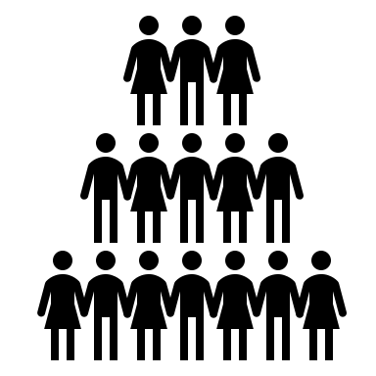





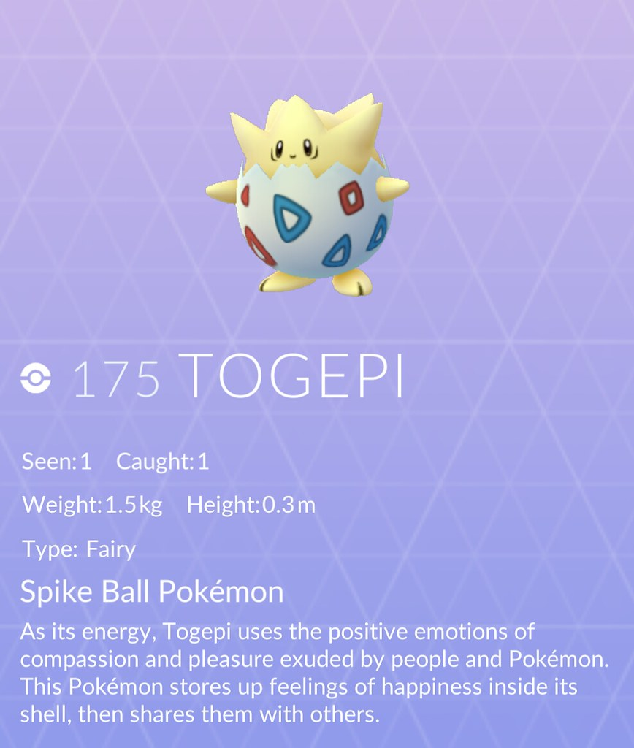


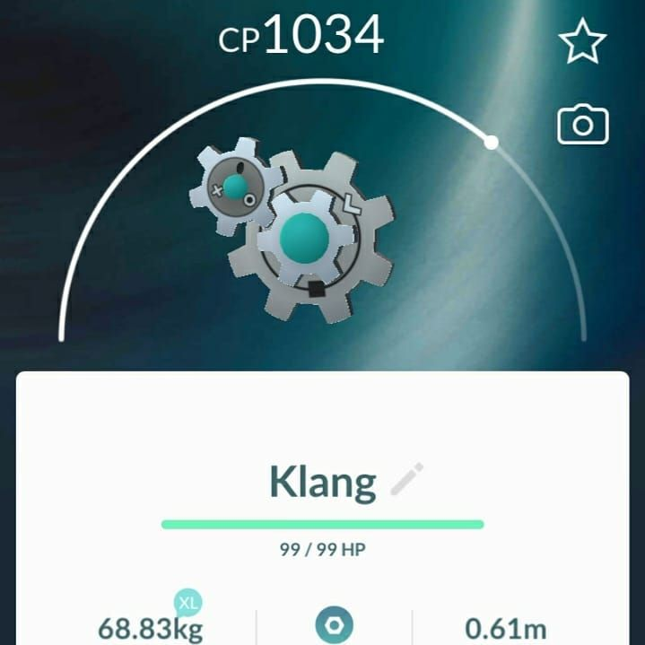
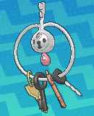


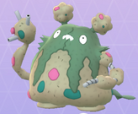
Other use cases
Customer recommendation systems: “People who bought Harry Potter and the Philosopher’s Stone also bought The Hunger Games…”
Grouping DNA sequences of different strains of HIV into families of genetically similar viruses
Identifying fake news by clustering the words used in articles. Certain words may appear more in sensationalized click-bait articles.
And the more frivolous and fun side projects…
Recommend
cutest
coolest
grossest
Notes:
So one of it’s most popular applications involves the world of marketing and sales
Clustering is used to group customers according to what they’ve bought – purchase information and customer traits are used to develop recommendation systems. You’ll often see suggestions when using sites like Amazon which say something like “People who bought X also bought Y”. By collecting customer purchase data we can identify a cluster of books that are popular with a certain audience. So then when we have an individual that buys 2 particular books (as shown in the picture – maybe these are HP or the HG), we can recommend them a 3rd book (say LOR) based on what other customers like her have bought.
We also have less capitalist clustering applications. So scientists and biologists will often use clustering methods to group genetically similar viruses together. Helps improve our knowledge of certain viruses like Covid-19.
Successful attempts have also been made to counter the spread of fake news online, with articles that include a high % of certain terms being deemed to have a higher probability of being fake or misleading. So, we could have 1 cluster for words/terms associated with fake news, and another cluster for words/terms associated with true articles.
And of course, we also have more frivolous and fun uses such as the image shown on the right which shows the results of clustering on a Pokemon dataset, where Pokemon were grouped according to their attributes – we end up with 3 clusters: coolest pokemon (Squirtle wearing his shades), cutest pokemon (classic 2nd gen Togepi), and finally the rather unfairly named ‘grossest’ pokemon which include poorly inspired Pokemon such as Klefki which is just a bunch of keys.

Slide 11

What is a cluster?
“There is no universal definition of what a cluster is: it really depends on the context, and different algorithms will capture different kinds of clusters.”
(Géron, 2019)
Notes:
But what is a cluster? What are these groups that we’re searching for in our datasets?
Here I have a really important quote from Geron which states: “There is no universal definition of what a cluster is: it really depends on the context, and different algorithms will capture different kinds of clusters”.
These clusters/or groups don’t exist out there in the world, they exist with how we interact with data. You can think about a box of lego for instance, there’s numerous ways we could divide this box of lego – could split it into 2 clusters, or 3 or 4 clusters, or even 50. It depends on the context, and the criteria that we specify. If we think back to our Pokemon example, I could have split my coolest Pokemon cluster into another cluster for ultra-cool Pokemon that wear shades. Or for my cutest Pokemon cluster, maybe I split it again to distinguish between Pokemon that are cute Fairy-types and cute Water-types. Or maybe I could merge my coolest and cutest Pokemon into a bigger cluster called “best Pokemon”.
However, there will be times where you know a bit more about the clusters you want to produce. For instance, perhaps you’re working with clustering individuals by their gender, in this case you can expect that there will be at least 2 clusters.

Slide 12
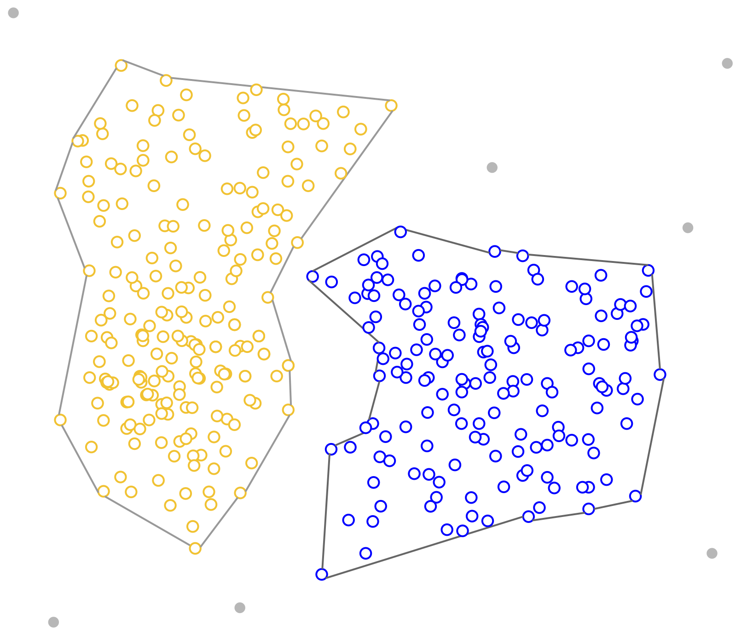
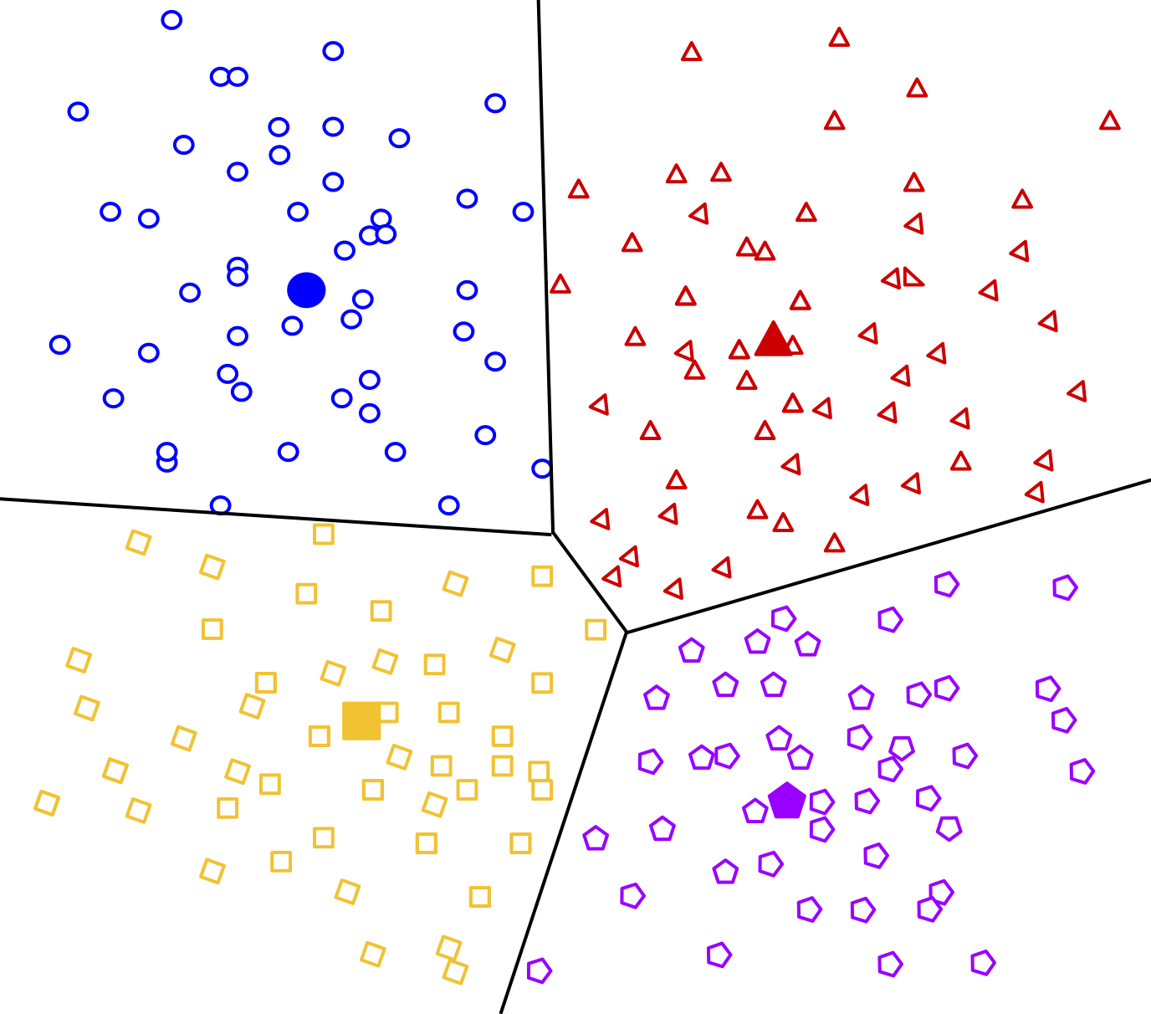
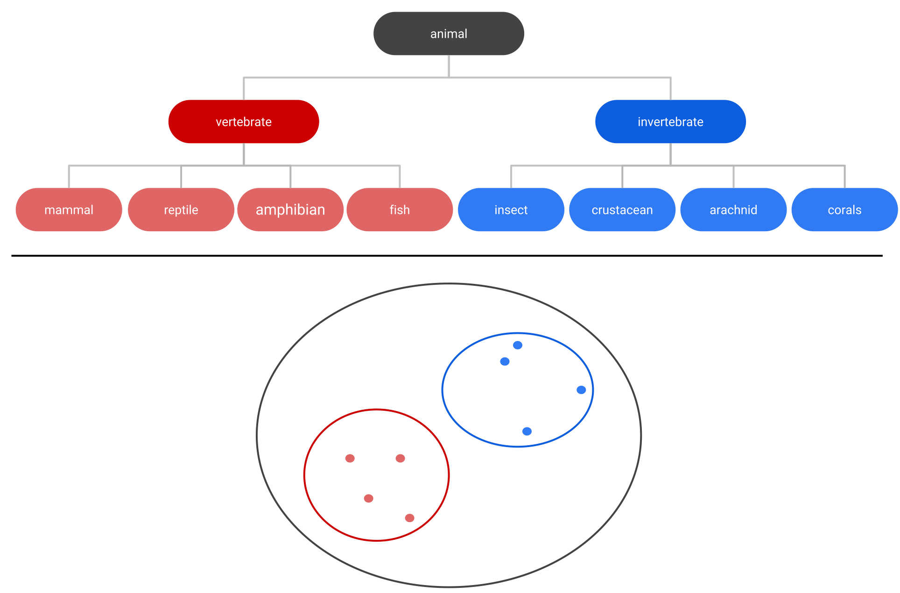
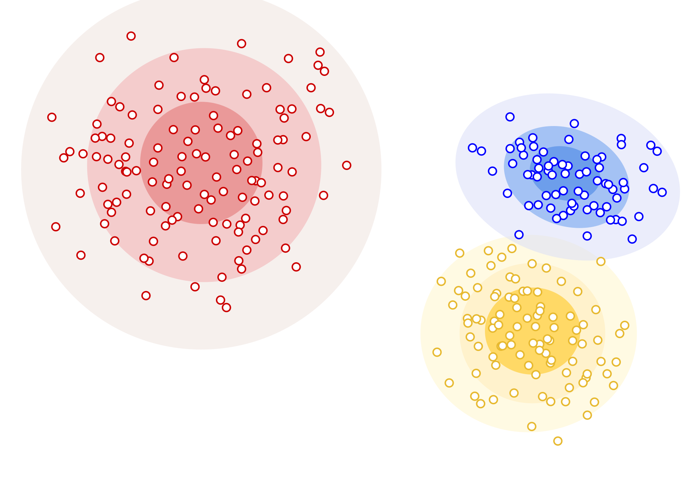


Types of clustering algorithms
Centroid-based
Density-based
Distribution-based
Hierarchical clustering
How do I know which type of algorithm is right for me?
?
?
?
EXPLORE YOUR DATA
Notes:
In terms of types of clustering algorithms, the utility of/how useful different algorithms are will depend on the context, and the nature of the problem that you’re trying to solve.
Centroid-based clustering (or representative-based) assigns each data point to a number of centroids (here, we have 4) to form groups or clusters. Centroid-based algorithms (like the k-means algorithm) are efficient, effective, and simple to implement, but are sensitive to initial conditions and outliers.
Density-based clustering (which includes the well known DBSCAN algorithm) works by separating high-density regions of data points from low-density areas. Unlike centroid-based clustering, there is no need to be sensitive about initial conditions (we don’t have to pick a number of centroids), and these algorithms don’t assign outliers to clusters. However, they struggle to perform well with data of varying densities and high dimensions.
We also have Distribution-based clustering, which contrasts with our 2 previous examples. Centroid-based clustering is based on proximity (similarity/distance), and density-based clustering is based on composition (density), whereas, distribution-based clustering takes probability into consideration. So, data points are grouped based on their likelihood of belonging to the same probability distribution (so that could be Gaussian, Binomial etc). The advantage that these algorithms have over centroid-based algorithms, is their ability to model diversely sized clusters. The disadvantage however, is that these algorithms tend to only work well with synthetic data, or with data points that belong to a predefined distribution.
Finally, we have hierarchical clustering which (like centroid-based clustering) is based on proximity (similarity/distance), with the idea that each object is connected to its neighbors depending on the distance (or the degree of the relationship). It works by creating a tree of clusters which are represented as Dendrograms, where the X-axis represents objects that don’t merge, while the Y-axis is the distance at which clusters merge. These models are better than centroid-based algorithms at dealing with non-convex clusters and we don’t have to initialize (or set) the number of clusters (or k-representatives) beforehand. However, these type of clustering algorithms can be slow, and they often don’t perform well on a large database.
Understandably, that’s a lot of information to take in. But the reason I’m covering these different types of algorithms is to illustrate that each type of algorithm has its pros and cons. But you might be wondering how it is you decide on a type of algorithm. My main advice that I can’t stress enough: is to explore your data. This will help you weed out some of the less suitable algorithms. So you might want to determine if your data falls into a predefined distribution, if not that’s going to rule out your distribution-based algorithms. Or maybe you’re working with a large dataset, in which case you might avoid using hierarchical clustering. But, I also recommend just trying out a couple of different methods too. There’s a lot of great machine learning programming packages out there which will allow you to implement different types of algorithms and compare the results.
Right, so now that we’ve briefly covered the different types/range of clustering algorithms, I’m now going to focus in-depth on 2 different algorithms. The first algorithm that I’ll be covering is the aforementioned k-means algorithm, which is a centroid-based algorithm. Then I’ll talk for a bit about hierarchical cluster analysis.

Slide 13
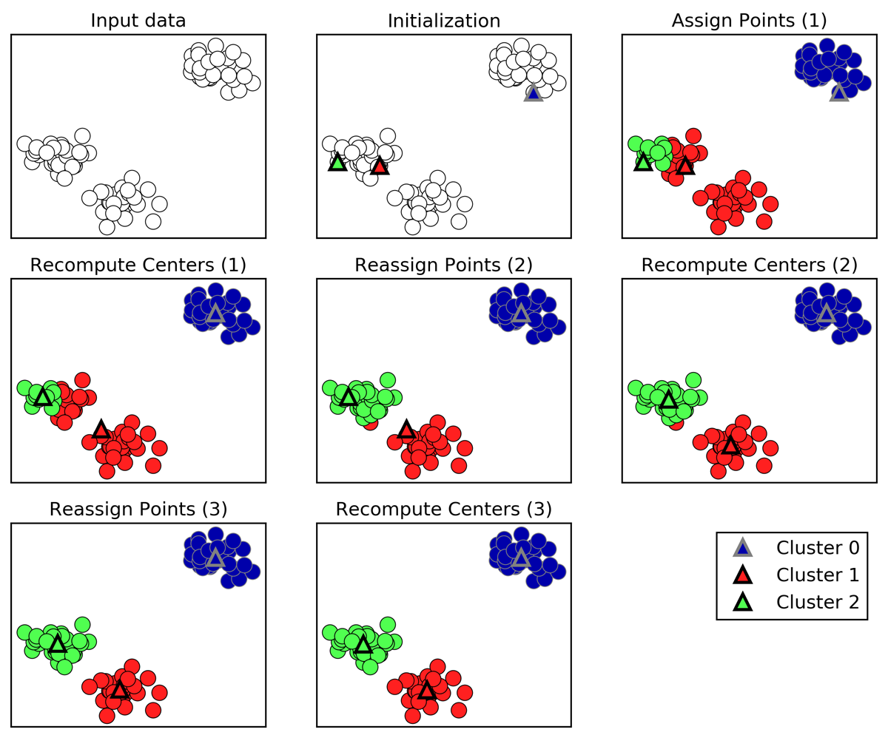
K-Means clustering
We want to separate our data points into k clusters
First, we initialize the algorithm with k random points (our centroids)
Then, we assign each data point to its nearest initialisation point – using the Euclidean distance
Once each data point is assigned, we relocate the initialisation point to the mean of the data points that were assigned to it
Repeat the highlighted steps until the assignment of data points to centroids remains unchanged
Notes:
So, how does K-Means clustering work?
Well, we start with a collection of data points (our input data) and we want to separate them into k clusters (and we pick what k is equal to, so we decide the number of clusters as part of the initialization process). And the center of these clusters are represented by something called ‘centroids’. So, on the picture you can see that we have initialized this algorithm with 3 random data points (these 3 points will become our centroids), and they’re represented by the little triangles, so you can see in the second image we have a green, red, and blue triangle.
Then, we assign each data point to its nearest centroid. Remember, this is a proximity-based algorithm, so we use a distance measure (i.e., the Euclidean distance) to calculate the distance from each point to its nearest cluster. In the third image you can see that we’ve assigned our points – each point is now coloured.
Once we have assigned all points, we relocate the initialization point (the triangles) to the center of its cluster – to the mean of the data points that were assigned to it. If you look at the fourth picture you can see that the triangles have moved slightly. We can see that the red triangle has moved quite a bit, whilst the green triangle has only shifted slightly. The blue triangle has also moved quite a bit.
Then the process is repeated. So, based on our new centroids (shown in picture 4), we reassign each data point to its nearest cluster. Then we recompute the centers.
When we recompute our centers again in picture 6, we can see that our triangles are now well placed in the center of each cluster.
This process continues until the assignment of data points to centroids remains unchanged. At this point, the algorithm stops as we have reached ‘convergence’. And you can see that we have 3 clearly defined clusters, of red blue and green data points.
PERFORMANCE METRIC - The quality of the cluster assignments is determined by computing the sum of the squared error (SSE) after the centroids converge. So, the aim of the algorithm is to minimize this number so that we have good quality clusters.
But, the key to finding good clustering solutions with the K-Means algorithm is to run it multiple times with different random initialization points. In this example here, our algorithm has found a good solution with very few runs – we only recomputed our centers 3 times. However, this isn’t always the case. Because our centroids positions are chosen at random, this can produce different results on successive runs. That’s why it’s important to run it multiple times.

Slide 14

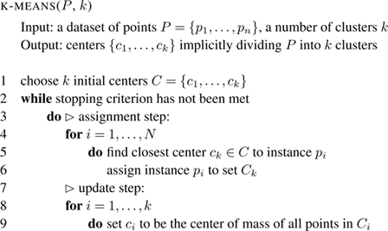
Introducing pseudocode…
Notes:
Another thing I want to briefly introduce is something called pseudocode. Some of you may already be familiar with this concept, but I expect we have many beginners that are wondering what I’m blathering on about. As we know, we use a programming language and computer software to implement machine learning algorithms.
What Pseudocode does is it uses structural conventions of a normal programming language, but in a way that makes an algorithm digestible for our human-thinking brains. So you can think of it as a recipe that you’ll follow and execute in a given programming language. It’s an informal way of writing a set of instructions without relying heavily on specific syntax.
What I’m going to do is show you how we can go from writing a sort of basic to do list, to translating this into pseudocode, then writing actual code. So, we can sort of think of this as a 3 step process.

Slide 15
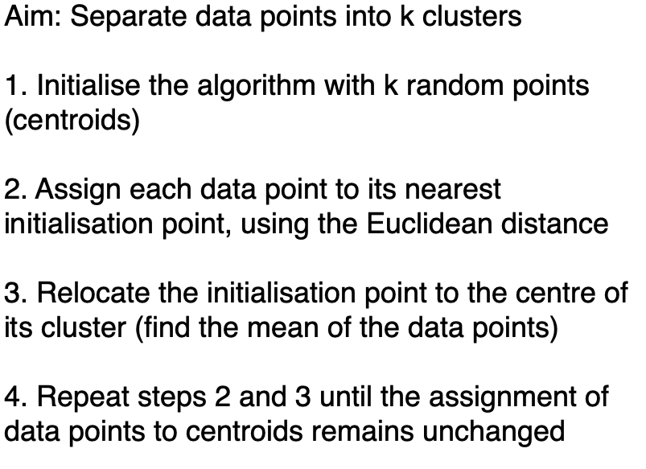

Pseudo English
Notes:
So, here we have step 1.
Writing pseudocode can seem intimidating at first, so a good step to start with is writing your algorithm in ‘pseudo English’. All of us know how to write a to do list, so you can just start off with a very simple numbered list. Then you can start to think about how to translate this to pseudocode.

Slide 16
Pseudocode
Notes:
So now we can look at translating this Pseudo English into pseudo code, and a good first step in this translation process might be defining our input and output, as you can see we have our input P which is our set of data points, and our expected output which will be our k clusters.
And you’ll notice we have some mathematical notation and programming syntax here.
You can see that we’ve sketched out where our while loops and for loops will be.
And this is going to make it easier for us to take the next step and translate this into code.
But, don’t worry if this still looks crazy to you! I don’t expect anyone to be familiar with for loops or while loops, or programming syntax for now.
This is just highlighting how we can go from pseudo English to pseudo code.

Slide 17
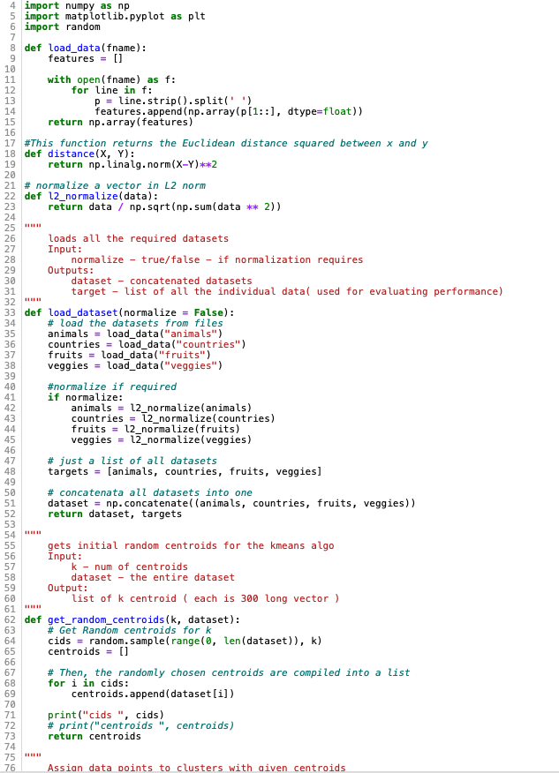
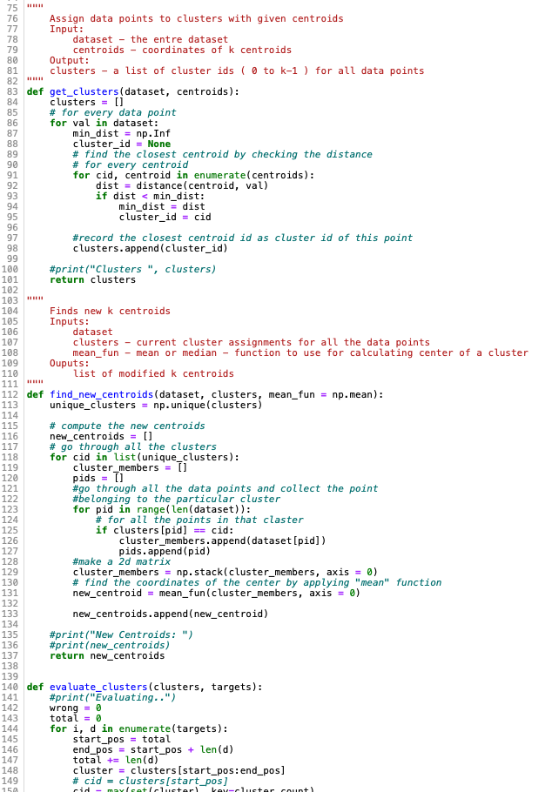
Code
Notes:
Finally, we have step 3 where we translate our pseudocode into actual code.
And to do this, we use our pseudocode (which is essentially the recipe for our algorithm) which acts as a guide that we can follow throughout.
Makes the whole process of writing code much easier.
I’m not expecting any of this code to make sense to you, so don’t worry I’m just using this to illustrate the process of translating pseudocode into code.
Now, returning back to the K-Means algorithm…

Slide 18
Initialisation – how do we select our centroids?
Forgy’s method: choose k random data points from the dataset
Random Partition method: Randomly assign data points to a cluster. Then calculate the mean of each cluster to get the initial centroids.
K-means++: first centroid is a random datapoint, but remaining centroids are chosen based on the maximum squared distance → centroids are spread out evenly
Notes:
So, I mentioned in the previous 2 slides that the first step in this algorithm is the initialization process, where we select our k, and thus our number of centroids.
There are many different ways to approach this initialization process.
And it’s worth being strategic about how we choose our centroids, as ultimately, the results of our k-means will depend upon the initialization. If we think about the algorithm and how it works, we have this 2-step iterative process where we repeatedly recompute our centroids and reassign our data points, but how many iterations it takes for the algorithm to converge will be largely dependent on the initial centroids. If we can optimally position these centroids we end up with a more efficient algorithm!
A traditional approach (known as Forgy’s method) involves selecting k number of data points at random from the dataset. This is is notable for being a fast initialization method which has the advantage of making it more likely that we will get a centroid that lies close to the modes of our dataset.
There’s also something called the random partition method, in which we assign the points to clusters at random then use the average of each group of points as the initial centroids. This tends to produce centroids which are close to the mean of the data, but does not work particularly well with the k-Means algorithm. If initialized using this method the k-Means is more likely to get stuck in a local minimum, which is a fancy way of saying it does not find the best solution → we want the global minimum.
Finally, however, moving away from different k-means methods, we also have the k-means++ algorithm, which uses a more strategic approach towards centroid initialization by randomly assigning the first centroid to a datapoint, then carefully choosing the remaining centroids based on the maximum squared distance. This ensures that the centroids are as far as possible from one another, which means fewer iterations!
Oftentimes the standard K-Means algorithm may be quicker than this k-means++ algorithm, but because K-Means uses random initialization we often end up with a local optimum because our initial centroids are not distributed over the data set. Apart from the way it chooses the initial centroids, the rest of the algorithm is exactly the same as the original k-Means. Generally works better than Forgy’s method and the Random Partition method.

Slide 19

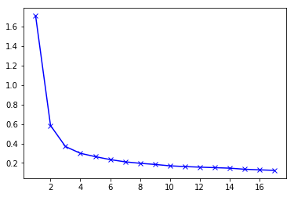
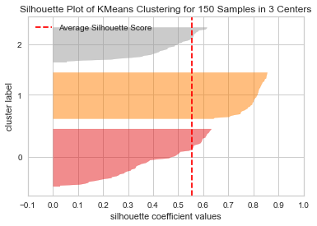
Okay… but how do we determine the number of clusters we want?
K = ?
Sepal length (cm) | Petal length (cm) | Petal width (cm)
3.5 | 1.4 | 0.2
3.2 | 5.7 | 2.3
3.2 | 5.9 | 2.3
2.9 | 4.7 | 1.4
3.7 | 1.5 | 0.4
Elbow plot
Each time we increase the number of clusters → the SSE decreases
Goal: select a small value of k that still has a low SSE
Elbow represents where we start to have diminishing returns by increasing k
SSE
k value
Notes:
So, we’ve figured out how we’re going to initialize our centroids, but how do we know how many centroids we need? I.e., how do we know how many clusters we want? What is the optimal number? In terms of the iris dataset Of course from having seen the labelled dataset before we know that there are 3 species of Iris to uncover. But you’ll be using clustering on unlabeled data, so you won’t know the number of groups hidden in the data. So, what do we do?
We can use something called the ‘elbow approach’ or the elbow method, which involves running the k-means algorithm with a range of different k values (say from 1-10) and then plotting our performance metric (that’s the sum of squared error that we mentioned previously) for each k. For those that don’t remember, the quality of our cluster assignments is determined by computing the SSE after the centroids converge. The SSE is the sum of squared Euclidean distances of each point to its closest centroid. So, the aim of the algorithm is to minimize this number so that we have good quality clusters.
So here is our SSE or elbow plot on the left. What you’ll notice on this plot is that each time we increase the number of clusters, the SSE decreases, which makes sense right. As more centroids are added, the distance from each point to its closest centroid will decrease. The SSE is 0 when k is equal to the number of data points in the dataset, because then each data point is its own cluster, and there is no error between it and the center of its cluster. (point about it not being a good thing)
So the goal of the elbow method is to find the point (i.e., the elbow) when adding more clusters no longer provides a significant decrease in the SSE. So, as you can see at first we have this very rapid decrease in the SSE, which drops off after k=3 where there is a bend, and after this bend we see a very slow and gradual decrease in the SSE value – the SSE starts decreasing in a linear fashion. This bend at k = 3 is the elbow, which indicates that 3 is the best number of clusters. We can see as well that after 3 we get diminishing returns when we increase k.
However, it should be noted that the elbow method is not the only method available for choosing the best number of clusters, nor is it the best method. It can have a hard time determining the optimal k value when there are clusters that are relatively close to one another. A solution to this/ a more precise approach is to use something called the silhouette score, which measures how close a point in one cluster is to points in the neighboring clusters. An example of a silhouette plot is shown on the right.

Slide 20


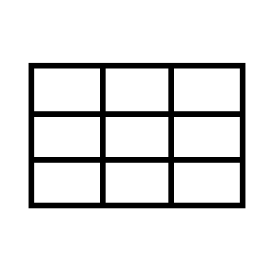
What are the strengths?
Easy to understand and implement
Fast
Scalable
Notes:
Before we completely trash the K-Means algorithm it’s worth mentioning its strengths. The main strength is that it’s very simple to implement, which is the reason why I chose it as one of my two clustering examples. It’s also fast, and scalable which means that it works well with large datasets due to its simple iterative nature (expectation-maximisation, 2 steps where we continuously recompute centers and reassign points until we reach convergence – it’s very simple to apply this to a larger dataset)– we have a set of centroids and each point can be independently assigned to its closest centroid and by assigning points to clusters, computing the optimum center is easily done by averaging the points.

Slide 21
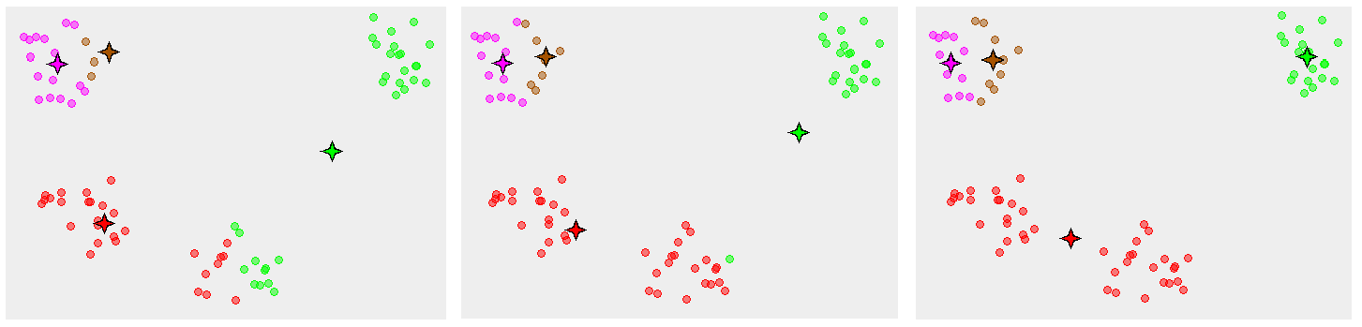
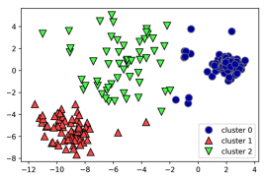
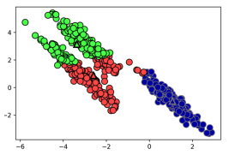
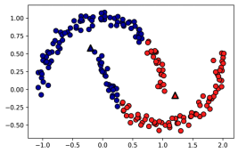
What are the limitations?
Choosing 𝑘 manually – it’s a hassle!
It is dependent on initial values: necessary to run the algorithm several times to avoid suboptimal solutions – converges to a local minimum
Not good at clustering data of varying sizes, densities, or nonspherical shapes
Elbow method
Bad centroid initialization
Suboptimal solution
density
direction
shape
Notes:
However, there are also some limitations that are worth discussing. This algorithm requires a bit of manual work, which includes selecting the k value and choosing a centroid initialization method. Remember that the results of our k-means will depend upon the initial centroid values, and we must run the algorithm several times to avoid suboptimal solutions. Therefore, the centroid initialization method matters, especially when our k value is high, as the number of iterations that it takes for the algorithm to converge will be largely dependent on the initial centroids. So, if we can optimally position these centroids we end up with a more efficient algorithm. The image on the right shows what happens when k-means converges to a local minimum and so produces counterintuitive results. Because the initial configuration places the pink and brown centroid quite close together, after 5 iterations they converge on a suboptimal solution. With a more sophisticated centroid initialization method we would expect to see a better result that better fits the obvious cluster structure of the dataset.
Also, K-Means can fail in cases where the data is of varying sizes, densities, or is nonspherical. The first image on the right shows some data which is densely packed in the blue and red cluster. Yet, there’s outliers that have been wrongly assigned to each of these clusters. This is because the k-means algorithm defines clusters by diameter only. Because clusters are circular, there’s also no way for k-means to account for direction, which is why it performed poorly in clustering the data in the second image. Finally, there is no way to account for cluster shape, which is why k-means peforms badly in the last image where we have an arbitrary shape. In this example The fact that K-Means assumes spherical shapes of clusters ((with radius equal to the distance between the centroid and the furthest data point) is also why it performs badly in the final image – it doesn’t let data points that are far away from each other share the same cluster even though they obviously belong to the same cluster.
Let’s move on now to hierarchical clustering.

Slide 22

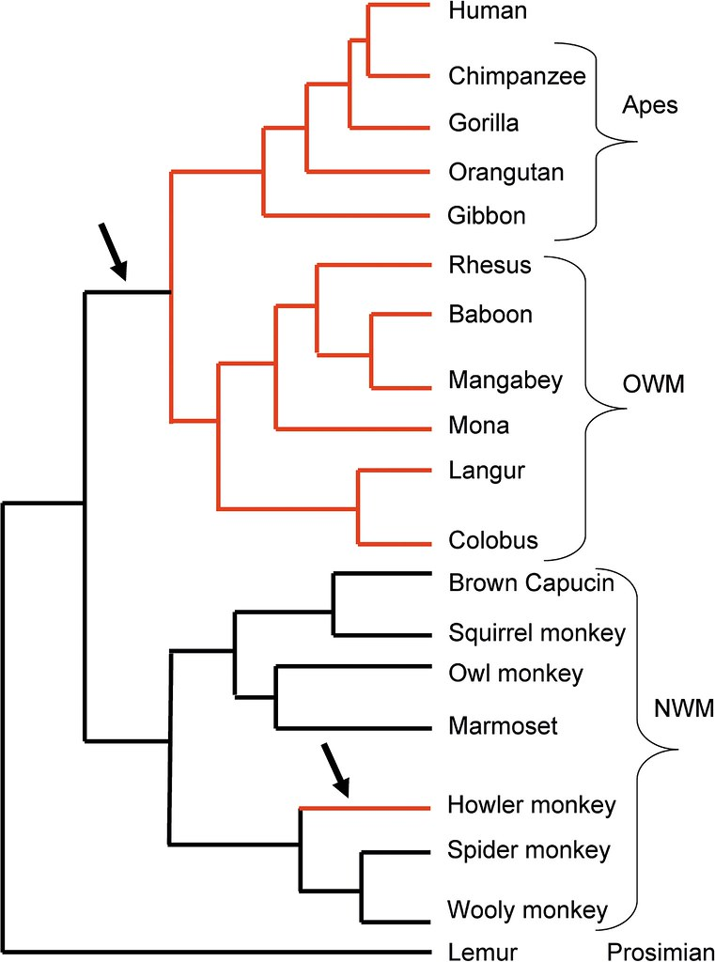



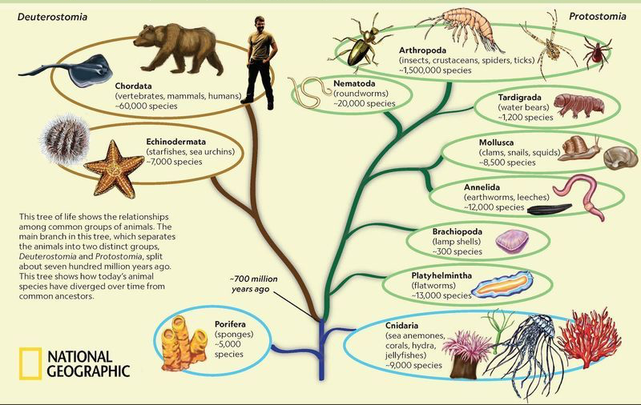
Hierarchical clustering
“Hierarchical clustering algorithms […] approach the problem of clustering by developing a binary tree-based data structure called the dendrogram. Once the dendrogram is constructed, one can automatically choose the right number of clusters by splitting the tree at different levels to obtain different clustering solutions for the same dataset without rerunning the clustering algorithm again.”
(Reddy and Vinzamuri, 2015)
Notes:
So, what is hierarchical clustering? And how does it differ to our K-Means algorithm?
Let’s start with a quote by Reddy and Vinzamuri (…)
Here I’ve highlighted 2 parts of this quote that are important when it comes to understanding the difference between k-means and hierarchical clustering. K-Means requires us to specify how many clusters we want in advance, whereas, a hierarchical clustering scheme by contrast builds clusters iteratively, by linking already existing clusters that are similar into larger clusters. Once the dendrogram is constructed we can slice it horizontally according to how many clusters we want.
On the right we have the output of hierarchical clustering which describes the relationship between different primates. We can see that humans are closely related to great apes like the Chimpanzee and gorilla. So that’s one cluster there. But when we can see we also have another cluster which includes old world monkeys that are not like apes in some ways – they have a tail. If we continued with this example, we could zoom out more and talk about primates as a cluster, and then mammals and so on.
If you look at this second picture we can see that we have an even more zoomed out dendrogram describing the relationships among groups of animals.
We’re gonna talk about it in a bit more depth now.

Slide 23
How do I read a dendrogram?
Increasing similarity
Branches
Split
Notes:
Let’s start with a very simple example.
So on the left we have our scatterplot of 6 random datapoints (A,B,C,D,E), and on the right is our dendrogram, the output of some hierarchical clustering algorithm.
The main thing to focus on when reading a dendrogram is the y-axis (or the height) which denotes the measure of distance or dissimilarity of either individual data points or clusters. In this case, similarity between objects is judged purely by their geographic x and y positions – they are most similar cos they are the most geographically close to each other. In this example we can see that A and B are most similar, as the height of the link that joins them together is the smallest. Whilst the next two most similar objects are D and E. In terms of the similarity between clusters, we can see that the main difference between clusters is between the cluster of C,A,B, versus that of D and E.
In the second image you can see that we’ve sliced the dendrogram horizontally (with a dotted blue line) so that all the resulting child branches formed below the cut represent an individual cluster – in this case we have 2 main clusters. But we could also perform another slice (which we’ve done with the orange dotted line) so that we have 3 main clusters, in this case we’d have {A,B}, {C}, and {D,E,F}.

Slide 24
What are the 2 main approaches to hierarchical clustering?
1) Agglomerative
2) Divisive
A
B
C
D
E
ABCDE
AB
DE
ABC
ABC
DE
AB
ABCDE
A
B
C
D
E
Notes:
When it comes to hierarchical clustering there are 2 main strategies for building our hierarchy of clusters: agglomerative and divisive hierarchical clustering.
Agglomerative clustering is the “bottom-up” approach where we consider each observation to be its own cluster, then merge the two most similar clusters, and so on.
Whereas, divisive clustering is a “top-down” approach which is essentially the opposite of the agglomerative approach. Instead, we start with our observations in one big cluster, and at each step we split a cluster until each cluster contains only one observation.
describes a collection of clustering algorithms that all build upon the same principles. So, we start by declaring each point as its own cluster. Then, we merge the two most similar clusters and then the next two most similar clusters, and so on, until some stopping criterion is satisfied.
So, as we have mentioned previously, hierarchical clustering is proximity-based and uses a distance metric (that measure of similarity or dissimilarity that we have mentioned) to measure the distance between our data points.
But agglomerative clustering also uses something called linkage methods (or linkage criteria) which provide a measure of dissimilarity between two clusters of datapoints – it’s a metric for how the “most similar cluster” is measured. Here I’ve listed the most commonly used linkage methods, which include: complete-linkage, single-linkage, average-linkage, and Ward’s minimum variance method. We’ll talk a bit more about linkage criteria in a second.

Slide 25
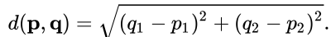
…but how do we know which clusters should be combined, or split?
1) Measure of distance – some measure of similarity
Hierarchical clustering is proximity-based
Affects the shape of the clusters
Used to build distance matrix
Default is Euclidean distance, but other measures exist: correlation-based, Levenshtein distance etc.
Increasing similarity
p | q | ED
3 | 4 | 1.414214
2 | 1
Notes:
The first ingredient necessary for either type of hierarchical clustering algorithm, is a measure of distance. Like our k-means algorithm hierarchical clustering is proximity-based, so we need some measure of distance (some measure of dissimilarity) between pairs of observations
The choice of distance measure is an important step in clustering as it defines how the similarity of 2 elements (data points) is calculated and therefore it will affect the shape of the clusters. The default distance measure is the Euclidean distance (which we came across in the k-means algorithm). You’ll remember in the previous example (which I’ve shown on the slide), similarity is based purely on the x and y positions of our 6 data points. For basic geographic clustering like this, the Euclidean distance is a simple and suitable distance measure to use. I’ve put the formula for the Euclidean distance on the right.
(I’m sure some of you will have seen it before and might think it’s incredibly simple (which it is once you understand it), but I’ve included a simple example in the table for those who may be unsure. Basically, we have our 2 coordinates for 2 observations (points), P (3, 2), and Q (4, 1). So we do q1 – p1 which is 4-3 = 1, then we square it which is 1, then we do q2-p2 which is 1-2 = -1, then we square it which is 1. We then add these results to get 2, and do the square root of 2 which gives us our answer 1.414214.)
Once we compute the distance between every pair of observations, we end up with a distance matrix.
But depending on the type of data and the researcher questions other dissimilarity measures may be preferred. So, there’s other ways that we can build this distance matrix.
E.g. when it comes to studying gene expression, correlation-based distance is often used as the distance measure because it considers 2 objects to be similar if their features are highly correlated, even if there Euclidean distance is far apart. Another way we can judge similarity is through the use of Levenshtein distance which measures the similarity between words which allows us to group text or other non-numeric data! We could use this for linguistic synonym clustering.

Slide 26
2) Linkage criterion – different ways to link clusters based on distance
A means of determining whether certain clusters should be merged
Default is complete-linkage
Other commonly used linkage criteria: single-linkage, average-linkage
Used to update the distance matrix and merge clusters
Notes:
The next thing we’ll need to define is our linkage criterion, which determines the distance between sets of observations as a function of the pairwise distances between observations. This sounds complicated, but in simple terms the linkage criterion is just a means of determining whether certain clusters should be merged. Different linkage methods will produce different results – hierarchical clustering dendrogram output will look different.
Complete linkage clustering is the distance between the most distant elements in each cluster.
Some of you may still be confused about how the measure of distance and linkage criterion work so I’m going to illustrate how this works with an example.

Slide 27
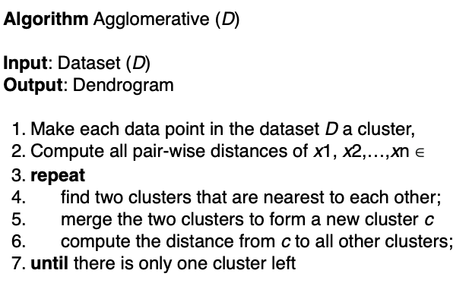
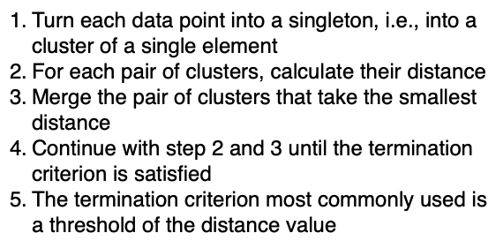
Agglomerative hierarchical clustering: Using complete-linkage
PSEUDO ENGLISH
PSEUDOCODE
Notes:
So, to get a more in-depth view of hierarchical clustering we’re going to focus on an example which uses the agglomerative approach with the complete-linkage method.
Again, we have some pseudo English here, which is our very simple to do list for this algorithm.
Then, on the right we have our pseudo code, which we have built by translating our pseudo English into a more refined recipe that uses structural conventions of a programming language. You can see we have our input which is our dataset D, and our expected output which is a dendrogram describing the relationship between our clusters. You can see we also have a bit of maths notation in here so we have our datapoints listed as x1, x2, until xn.
The main thing to remember when it comes to writing pseudocode is that it should be clear and concise. It needs to be understandable, so that you can easily transcribe these steps into the programming language – into actual code.

Slide 28
Step by step…
1) Load in dataset
x
y
Dps | sepal length (cm) | Petal length (cm)
A | 1 | 1
B | 1 | 0
C | 0 | 2
D | 2 | 4
E | 3 | 5
Notes:
Let’s look at this algorithm in-depth.
So, first we have our Iris dataset shown here, with our 5 data points (A,B,C,D, and E) and our x and y (our 2 features which are sepal length and petal-length). And on the right we have the scatterplot of these points.

Slide 29
2) Build distance matrix and identify smallest distance
 | A | B | C | D | E
A | 0 | 1 | 1.4 | 3.2 | 4.5
B | 1 | 0 | 2.2 | 4.1 | 5.4
C | 1.4 | 2.2 | 0 | 2.8 | 4.2
D | 3.2 | 4.1 | 2.8 | 0 | 1.4
E | 4.5 | 5.4 | 4.2 | 1.4 | 0
Notes:
After we load in our dataset we can move onto step 2, which involves using some measure of distance to build a distance matrix. In this case, I’ve used the default measure which is the Euclidean distance, and as you can see I’ve caculated the distance between each pair of observations. In a distance matrix, all entries on the main diagonal will be 0, as the distance between A and A will be 0, as will the distance between B and B and so on. You’ll also notice that the matrix is symmetric, which is why for the next step I’ve chosen not to fill in the matrix completely, just so the results are easier to read.
Okay, so once we have our distance matrix and now we look for the pair of points with the smallest distance, which in this case is A and B.
You can see that I’ve highlighted the cell with this smallest distance in yellow.

Slide 30
3) Perform merge and update distance matrix
Updated distance matrix:
 | AB | C | D | E
AB | 0
C | 2.2 | 0
D | 4.1 | 2.8 | 0
E | 5.4 | 4.2 | 1.4 | 0
d[(A,B),C] = max {d(A,C), d(B,C)}
= max {1.4, 2.2}
d[(A,B),D] = max {d(A,D), d(B,D)}
= max {3.2, 4.1}
d[(A,B),E] = max {d(A,E), d(B,E)}
= max {4.5, 5.4}
Notes:
So, we perform our first merge and update our distance matrix. Remember that the distance matrix is symmetric which is why I’ve not filled it in completely, just so its easier to read. Here we have our updated distance matrix with our A and B points merged into their own cluster.
And now that we have our updated distance matrix and this is where our complete-linkage method comes in as we need some means of measuring the distance between two clusters in order to perform our next merge. To do this, we find the maximum distance between elements of each cluster. So, it’s just a case of referring to our original distance matrix to find the right numbers.
Let’s look at the first clusters, so we have AB and C. Here, we simply locate the distance between A and C which we can see is 1.4, and compare it to the distance between B and C, which is 2.2. So, the max distance here (we can see) is 2.2. So we enter that in the updated distance matrix. We then do the same with cluster AB and D, and find that the maximum distance between these two clusters is 4.1. And of course we do the same for AB and E. With the rest of the entries, we are only comparing one element to another, you know we have C and D, C and E, and E and D. So, we simply enter the Euclidean distance which we computed in step 2.
After doing this, we look for our smallest distance in the matrix, which is 1.4, for points E and D. So we perform our second merge, and go on to update our distance matrix which we will see on the next slide.

Slide 31
Continue merging and updating the distance matrix…
 | AB | DE | C
AB | 0
DE | 5.4 | 0
C | 2.2 | 4.2 | 0
 | ABC | DE
ABC | 0
DE | 5.4 | 0
d[(A,B),(D,E)] = max {d((A,B)D), d(A,B)E))}
= max {4.1, 5.4}
d[(C,(D,E))] = max
{d(C,D), d (C,E)}
= max {2.8, 4.2}
d[(A,B,C),(D,E) = max
{d((D,E)(A,B), ((D,E,(C))
= max {5.4, 4.2}
Notes:
As you can see, we repeat these same steps of finding the maximum distance between our clusters and merging those with the smallest distance, until we end up with our result.

Slide 32
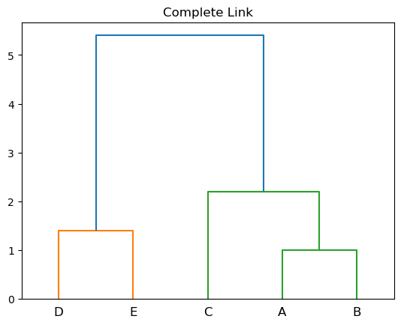
RESULT
Dendrogram: y-axis denotes when in the agglomerative algorithm two clusters get merged
Y-axis also shows how far apart the merged clusters are → pay attention to the length of the branches
two clusters
three clusters
Notes:
This is the output of our agglomerative hierarchical clustering on our dataset. We have our measure of cluster distance on the y-axis, and we can see that our first cluster A and B, were merged at 1. The height of this link (1) is equal to the Euclidean distance between A and B. Whereas, the second cluster D,E, was merged at 1.4 – again that’s equal to the Euclidean distance between D and E. Then we have A,B and C which were merged together at height 2.2., and finally we have ABC merged with DE at height 5.4 which was the result of selecting the maximum distance between AB and D and AB and E.
The y-axis also shows us how far apart the merged clusters are: the longer the branch, the further apart the merged clusters are. We can that the longest branches in this dendrogram are the two lines that are marked by the blue dashed line labelled “two clusters”. That these are the longest branches indicates that going from two down to one big cluster meant merging some very far-apart points.

Slide 33
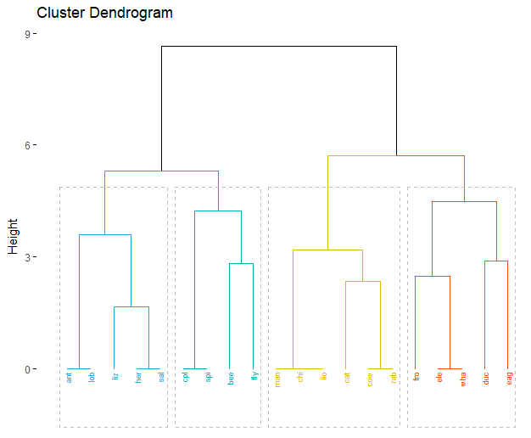
What are the strengths?
Easy to understand and implement
Most appealing output
Can handle non-convex clusters
No need to specify the number of clusters!
K = ?
Notes:
First, let’s quickly discuss the strengths of hierarchical clustering. It’s main strength is that its easy to understand and easy to implement. Out of the 4 types of clustering algorithms that we discussed: centroid-based, distribution-based, density-based, and hierarchical clustering: the math of hierarchical clustering is by far the easiest to understand and program.
It’s main output (dendrogram) is also the most appealing in terms of outputs of clustering algorithms – it gives you a big picture overview, and highlights groups in your data. Also, compared to the K-Means algorithm, hierarchical clustering is better at generating results when dealing with non-convex clusters. And there’s no need to specify the number of clusters you want before running the algorithm! Finally, we can view results at multiple levels of granularity.

Slide 34

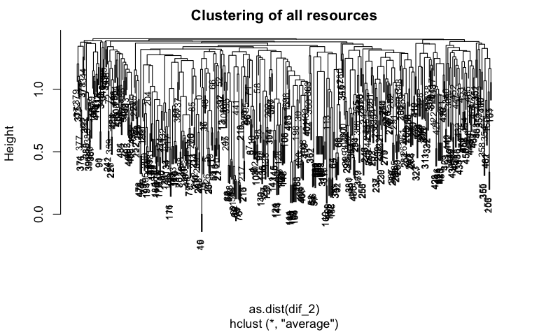

What are the limitations?
Mathematically simple…but computationally expensive!
Hard to visualize results with a large dataset
Heavily driven by heuristics and arbitrary decisions
Algorithm can’t undo previous step
Notes:
But, there are of course limitations to this type of clustering as well. Although it’s mathematically very simple, these algorithms are quite computationally expensive. In any of these algorithms you will have to keep calculating the distances between data samples/subclusters which increases the number of computations required. This is especially so if you’re working with a large dataset. Large datasets also mean that results are hard to visualize. When the number of data points increases, it becomes difficult to visually analyze our dendrogram, and so it becomes harder to make decisions such as: where to perform splits etc. This is a real one that I produced as part of a work project, and as you can see it’s not the best to look at.
Plus, when you begin analysing and making decisions with dendrograms, you’ll realise that hierarchical clustering is heavily driven by heuristics. This leads to a lot of manual intervention in the process and consequently, domain-specific knowledge is required to analyse whether the result makes sense or not – whether the clusters have been optimally split – objects may be incorrectly grouped at an early stage. So we have to examine the results closely to make sure it makes sense. It also involves a lot of arbitrary decisions: when using hierarchical clustering it’s necessary to specify the distance metric and linkage criteria. But there is rarely any strong theoretical basis for these decisions and each method comes with its own limitations. And this lack of theoretical basis contradicts a core principle of scientific research, which is that findings are not the result of arbitrary decisions, which makes the technique dubious.
Finally, the algorithm can’t undo any previous steps. So if it clusters two points, and later on we see that the connection was not a good one, the program can’t undo that step.

Slide 35
K-Means vs Hierarchical clustering
 | K-Means | Hierarchical clustering
Time complexity | O(n) | O(n²)
Hyperparameters Tuning | Must specify the number of clusters (k) and retrain model for each k | No need to specify k value, can perform split wherever
Data structure | Better performance when dealing with convex clusters | Generates better results when dealing with non-convex clusters
Types/variations | Many variations (e.g., K-median, K-medoid) | Two approaches: Agglomerative and Divisive
Result Robustness | Result may be different on different runs | Same parameters generate the same result every time
Notes:
To summarise, let’s look at the differences between the K-Means algorithm, and hierarchical clustering algorithms.
We first have a category called time complexity. This is a computer science term which describes the amount of time it takes to run an algorithm. The amount of time is defined as a function of the length of the input. This sounds weird and complicated, so there’s a link in the slide here for anyone who’s interested in learning more about it. Basically, for K-Means, our time complexity is linear – meaning the running time increases linearly with the length of the input. Whereas, hierarchical clustering algorithms have a time complexity of O(n2), which means the time complexity is quadratic – so the running time increases non-linearly with the length of the input. This time complexity shows us that hierarchical clustering can’t handle big data as well as K-Means can.
In terms of data structure, we’ve discussed that hierarchical clustering does better with non-convex clusters, whereas K-Means excels with convex clusters.
For type, we have many variations of the K-Means algorithm, so we have K-Median where unsurprisingly we use the median instead of the mean, and k-medoid. For hierarchical clustering we have two different approaches: agglomerative and divisive.
Finally for result robustness, K-Means will produce different results on different runs. Whilst, results are reproducible in hierarchical cluseing.

Slide 36
Any Questions…

Slide 37
References
Geron, A (2019). Hands-On Machine Learning with Scikit-Learn, Keras, and TensorFlow: Concepts, Tools, and Techniques to Build Intelligent Systems.
Müller, A.C, and Guido, S (2017). Introduction to Machine Learning with Python: A Guide for Data Scientists, O’Reilly Media, Inc.
Reddy, C.K., and Vinzamuri, B (2015). A Survey of Partitional and Hierarchical Clustering Algorithms.
Outlier detection using clustering (Outlier detection image) https://blogs.sap.com/2020/12/16/outlier-detection-by-clustering/
Image compression using K-Means clustering (parrot image) https://medium.com/@agarwalvibhor84/image-compression-using-k-means-clustering-8c0ec055103f
Clustering Algorithms: Types of Clustering (images) https://developers.google.com/machine-learning/clustering/clustering-algorithms
K-Means clustering (image with centroids as triangles)
K-Means pseudocode (image) https://www.cms.waikato.ac.nz/~abifet/book/chapter_9.html#rfig9-1
K-Means Elbow Method and Silhouette Analysis (image) https://stackabuse.com/k-means-elbow-method-and-silhouette-analysis-with-yellowbrick-and-scikit-learn/

Slide 38
Material for Tuesday the 2nd of November
GitHub:
https://github.com/UKDataServiceOpen/ML_Workshop

Slide 39
Survey
When you leave the webinar, please complete our short survey
Just click on ‘continue’ to access the survey.

Slide 40
Thank You.
Email:
louise.capener@Manchester.ac.uk
nadia.kennar@manchester.ac.uk,
Twitter:
@CapenerLouise
@NadiaKennar

